Slide 1
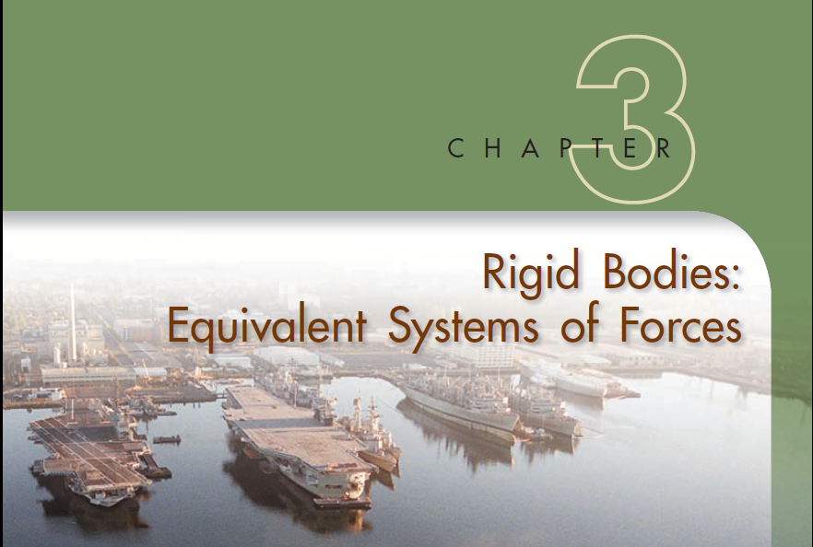

Slide 2

Most of the bodies considered in elementary mechanics are assumed to be rigid, a rigid body being defined as one which does not deform. Actual structures and machines, however, are never absolutely rigid and deform under the loads to which they are subjected. But these deformations are usually small and do not appreciably affect the conditions of equilibrium or motion of the structure under consideration. They are important, though, as far as the resistance of the structure to failure is concerned and are considered in the study of mechanics of materials
Forces acting on rigid bodies can be separated into two groups:
(1) external forces and (2) internal forces.
1. The external forces represent the action of other bodies on the rigid body under consideration. They are entirely responsible for the external behavior of the rigid body.

Slide 3
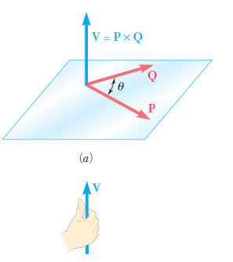
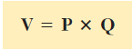
2. The internal forces are the forces which hold together the particles forming the rigid body. If the rigid body is structurally composed of several parts, the forces holding the component parts together are also defined as internal forces

Slide 4

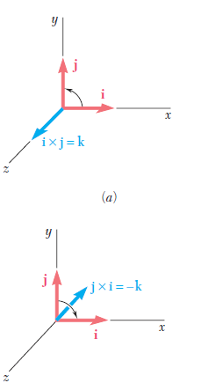
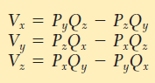
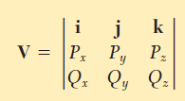
The vector product V can thus be expressed in the following form, which is more easily memorized

Slide 5

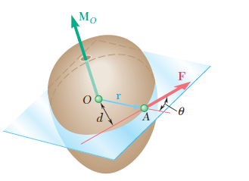
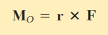
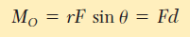
We will define the moment of F about O as the vector product of r and F :

Slide 6
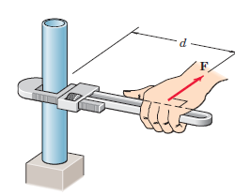
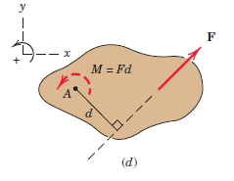
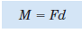
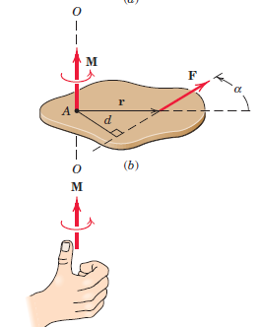
Moment about a Point
The moment is a vector M perpendicular to the plane of the body. The sense of M depends on the direction in which F tends to rotate the body

Slide 7

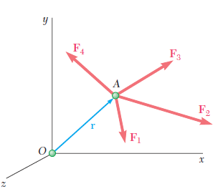
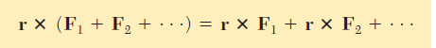
the moment about a given point O of the resultant of several concurrent forces is equal to the sum of the moments of the various forces about the same point O

Slide 8
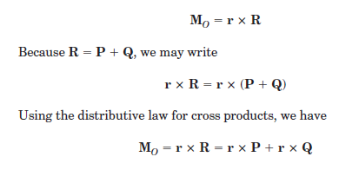
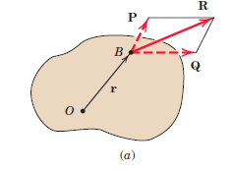
One of the most useful principles of mechanics is Varignon’s theorem, which states that the moment of a force about any point is equal to the sum of the moments of the components of the force about the same point.
The forces P and Q represent any two nonrectangular components of R. The moment of R about point O is
where we take the clockwise moment sense to be positive.

Slide 9

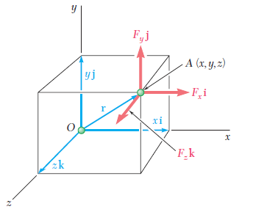
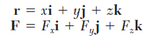


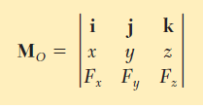
Consider, for example, the moment MO about O which is origin, of a force F whose components are F x , F y , and F z and which is applied at a point A of coordinates x , y , and z

Slide 10
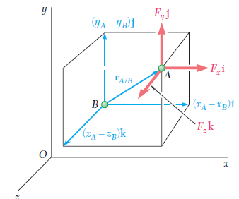
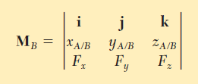
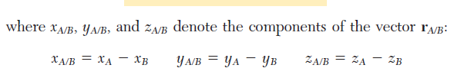
To compute the moment M B about an arbitrary point B of a force F applied at Awe must replace the position vector r in Eq. by a vector drawn from B to A .
This vector is the position vector of A relative to B and will be denoted by r A/B. Observing that rA/B can be obtained by subtracting r B from r A ,

Slide 11
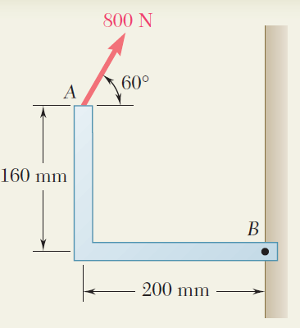
PROBLEM 1
Determine the moment of a force about B.

Slide 12
Determine the moment of a force about B.

Slide 13
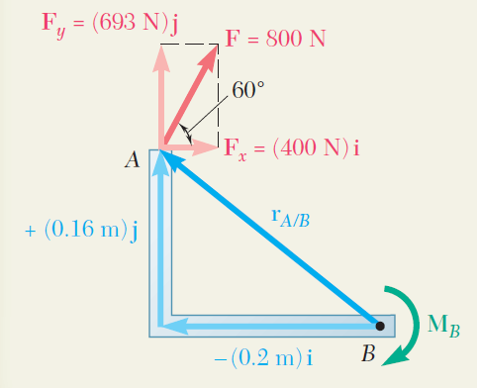

Slide 14
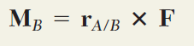
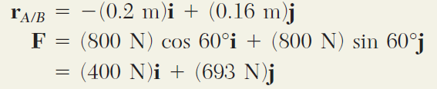
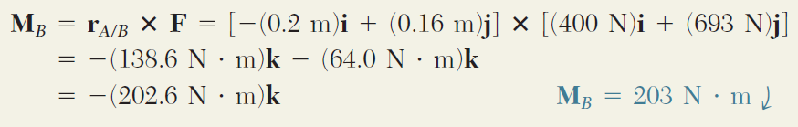

Slide 15
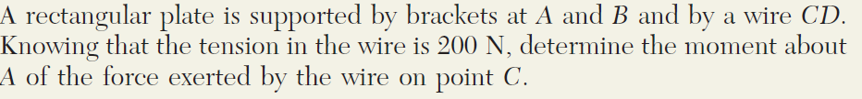
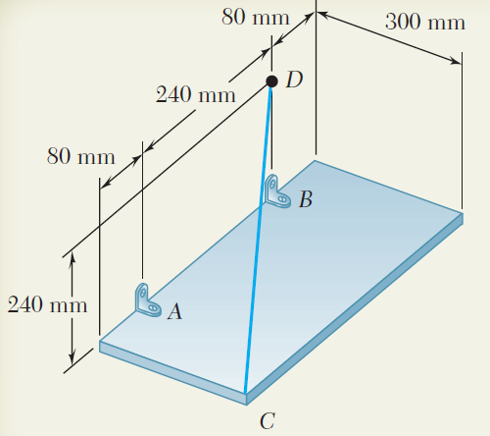
PROBLEM 2

Slide 16
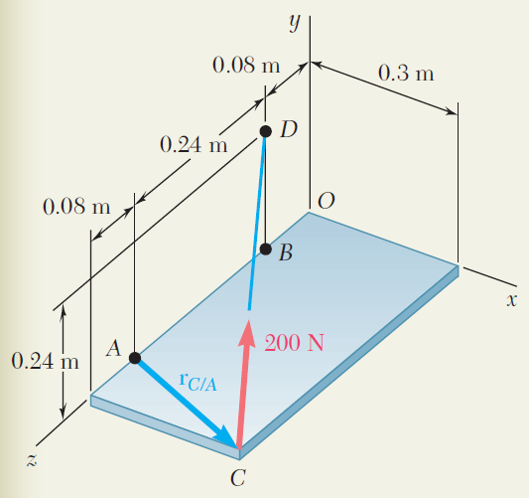

Slide 17
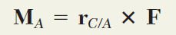
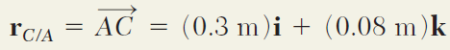
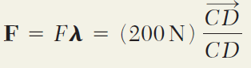

Slide 18
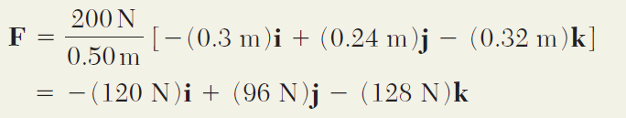
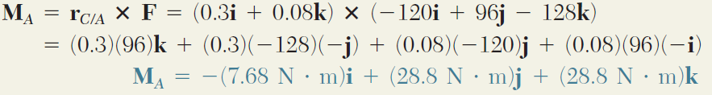

Slide 19
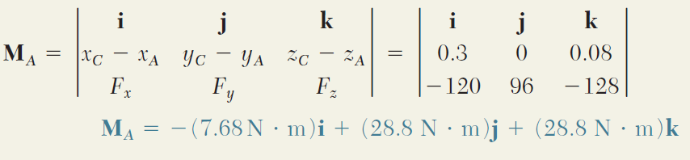

Slide 20
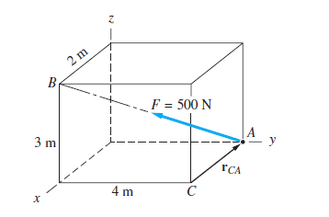
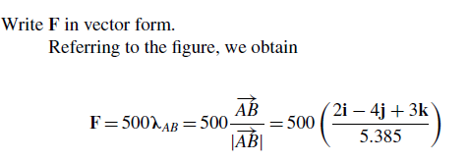
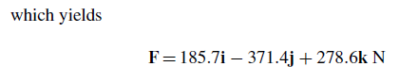
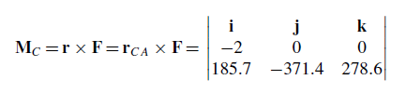
problem 3)
Determine (1) the moment of the force F about point C; and (2) the perpendicular
distance between C and the line of action of F.

Slide 21
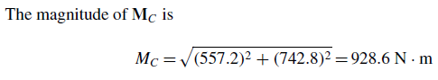
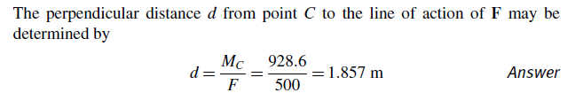

Slide 22
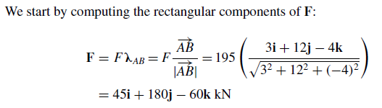
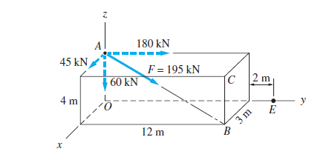
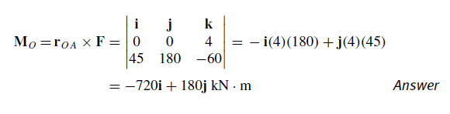
Problem 8) The force F of magnitude 195 kN acts along the line AB. find the moment of F about point O, ii) Determine the moment of F about the axis CE;

Slide 23
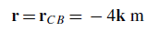
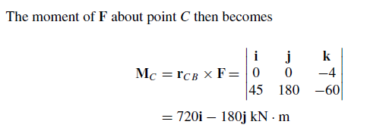

Slide 24
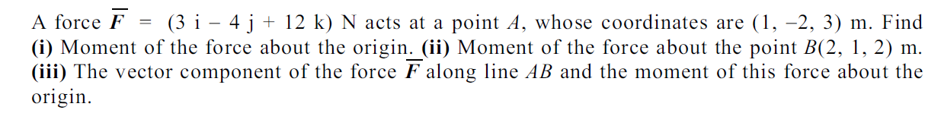
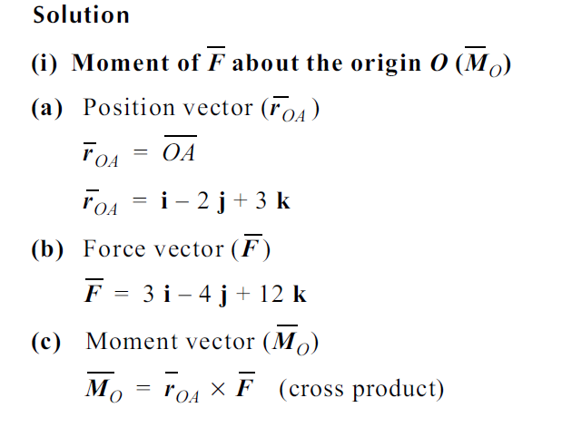


Slide 25



Slide 26


Slide 27


Slide 28

A parallelopiped as shown in Figure is acted upon by a force 200 N at E. Determine the moment of this force about (i) origin O, (ii) point H. [AD =BC = EH = FG= 200 mm]

Slide 29
A parallelopiped as shown in Figure is acted upon by a force 200 N at E. Determine the moment of this force about (i) origin O, (ii) point H. [AD =BC = EH = FG= 200 mm]
A = (0, 150,-100) mm
E = (300, 0,-100) mm
H = (300, 0,100) mm

Slide 30



Slide 31



Slide 32







Slide 33






Slide 34




we can introduce a new concept, the concept of moment of a force about an axis . Consider again a force F acting on a rigid body and the moment M O of that force about O WHICH IS ORIGIN
we define the moment M _{OL} of F about OL as the projection OC of the moment M O onto the axis OL .

Slide 35




MOMENT OF A FORCE ABOUT AN ARBITARY AXIS WHICH IS NOT PASSING THROUGH ORIGIN
The moment of a force F applied at A about
an axis which does not pass through the origin is obtained by choosing an arbitrary point B on the axis and determining the projection on the axis BL of the moment M B of F about B .
It should be noted that the result obtained is independent of the choice of the point B on the given axis.

Slide 36

Moment of a force about a point which is origin

Slide 37

Moment of a force about an arbitrary point which is not origin

Slide 38

Moment of a force about an axis which is passing through origin

Slide 39

Moment of a force about an arbitory axis which is not passing through origin

Slide 40

Problem 7)
The frame ACD is hinged at A and D and is supported by a cable that passes through a ring at B and is attached to hooks at G and H . Knowing that the tension in the cable is 450 N, determine the moment about the diagonal AD of the force exerted on the frame by portion BH of the cable
450 N

Slide 41
(0, 0.925, 0.35)m
(0.875, 0.75, 0)m
450 N
(1.0, 0, 0)m
(0.5, 0, 0.75)m
(0, 0, 0.75)m

Slide 44



Slide 45
Determine the moment M_{AB} produced by the force F in Fig. which tends to rotate the rod about the AB axis.

Slide 46


Slide 47



Problem 10

Slide 48

Couple
The moment produced by two equal, opposite, and noncollinear forces is called a couple. Couples have certain unique properties and have important applications in mechanics.
A couple is defined as two parallel forces with the same magnitude but opposite in direction separated by a perpendicular distance d. Couples are commonly applied as in the illustration below.
A torque or moment of 12 N·m is required to rotate the wheel.

Slide 49

Couples - Applications
When you grip a vehicle’s steering wheel with both hands, a couple moment is applied to the wheel.

Slide 50


Slide 51


we will state that two systems of forces are equivalent (i.e., they have the same effect on a rigid body) if we can transform one of them into the other by means of one or several of the following operations : (1) replacing two forces acting on the same particle by their resultant; (2) resolving a force into two components; (3) canceling two equal and opposite forces acting on the same particle; (4) attaching to the same particle two equal and opposite forces; (5) moving a force along its line of action. Each of these operations is easily justified on the basis of the parallelogram law or the principle of transmissibility.

Slide 52






Slide 53


Thus, any force F acting on a rigid body can be moved to an arbitrary point O provided that a couple is added whose moment is equal to the moment of F about O.
the couple vector is usually attached at O , together with F , and the combination obtained is referred to as a force-couple system

Slide 54




Slide 55



Problem 12

Slide 56



Slide 57
14
Find the resultant of the following force system and and location of resultant force from point O.
100 N
50 N
90 N
A
O
2.0m
3.0m
1.5m
2.0m
1.5m
70 N
86 N
34 N

Slide 58
100 N
90 N
50 N
R = 50N
A
O
2.0m
3.0m
1.5m
2.0m
1.5m
d
70 N
86 N
34 N

Slide 59
Find the equivalent force and couple at point A of the same force system
100 N
R = 50N
90 N
50 N
A
O
2.0m
3.0m
1.5m
2.0m
1.5m
3.5 m
70 N
86 N
34 N

Slide 60
Problem
_{R= 50 N}
O
A
_{C = 219 N-m}
Hence Equivalent Force
And couple at Point A is

Slide 61
15) Replace the given force system into equivalent force couple system at point o . where C1,C2 and C3 are the external moment acting on the system.
_{20 N}
_{30 N}
_{C3}
_{C1}
_{C2}
C₁ = 85 N-m
C₂ = 65 N-m
C₃ = 90 N-m
O
1 m
1 m
1 m
1 m
_{50 N}
_{40 N}
_{40 N}
(i)
(ii)

Slide 62




16)

Slide 63




Slide 68

A 300-N force is applied at A as shown. Determine ( a) the moment of the 300-N force about D, ( b) the smallest force applied at B that creates the same moment about D.

Slide 69


Slide 70



Slide 71



Slide 72


Slide 73


Slide 74


Slide 75


Replace the system of forces and couple shown in figure by a single force couple system at A.

Slide 76




Slide 77





Slide 78

i) Determine the resultant of the force system and locate it with respect to point A.

